Slide 1


Changes in the trade-wind atmospheric boundary layer due to mesoscale
SST variability in a coupled simulation
Presenter: Alessandro Storer
Supervision: prof. Claudia Pasquero
prof. Dino Zardi (Univ. Trento)
Meteo X Change conference, 10 – 11 April 2025

Slide 2
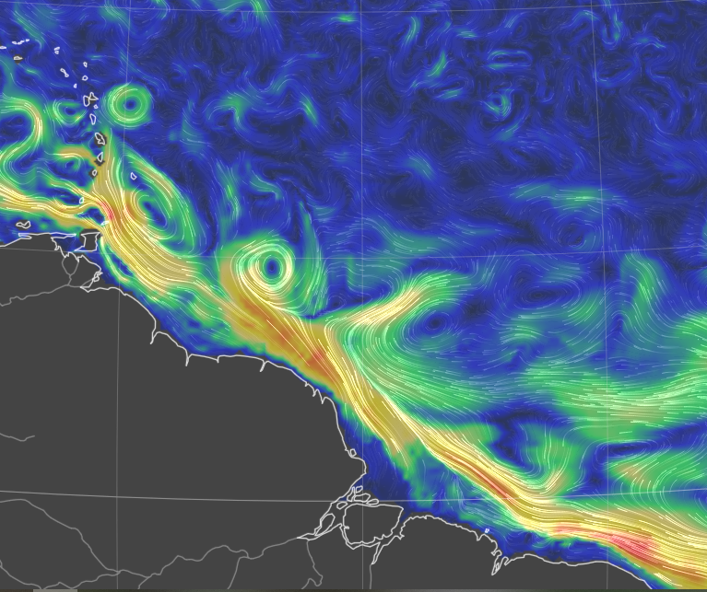
The Sub - / Mesoscale – an introduction
Important in the global energy budget!
(Renault et al. 2023, Seo et al. 2023,
Bishop et al. 2020)
Thermal feedback TFB
Modulates local temperature, stability and circulation through modified thermodynamic fluxes
10N
NUMERICAL DATASETS
- Conceptual bulk model for PBL
High-resolution coupled simulation:
WRF 2km atmosphere
CROCO 1km ocean
Daily averages in February 2020
EUREC4A region Stevens et al. 2021
EQ
60W
50W
40W
Sea sfc currents on 6 th April 2025
earth.null.school
Notes:
Check minobe’s and chelton’s, fabien’s articles for summarizing image

Slide 3
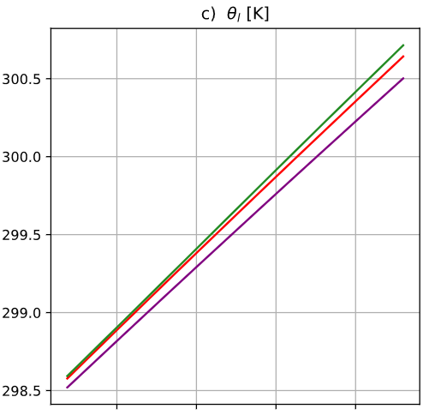
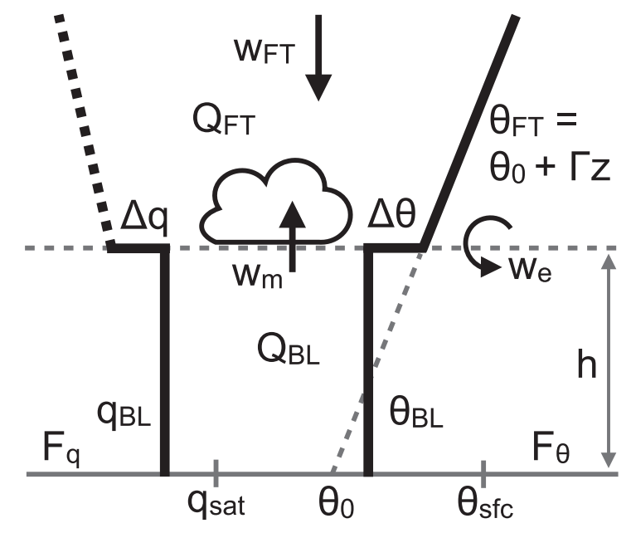
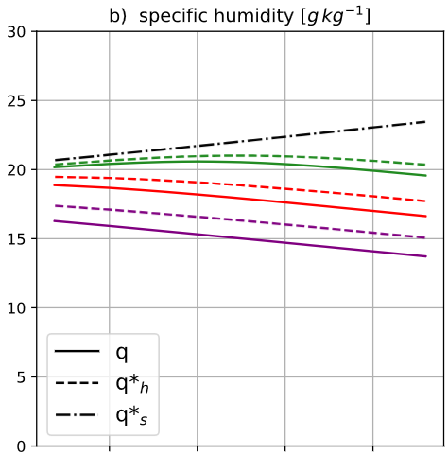
From lower complexity…
Conceptual Bulk model
Temperature follows SST
!?
Moisture decreases!
Stevens et al. 2002
Neggers et al. 2006
Naumann et al. 2019

Slide 4
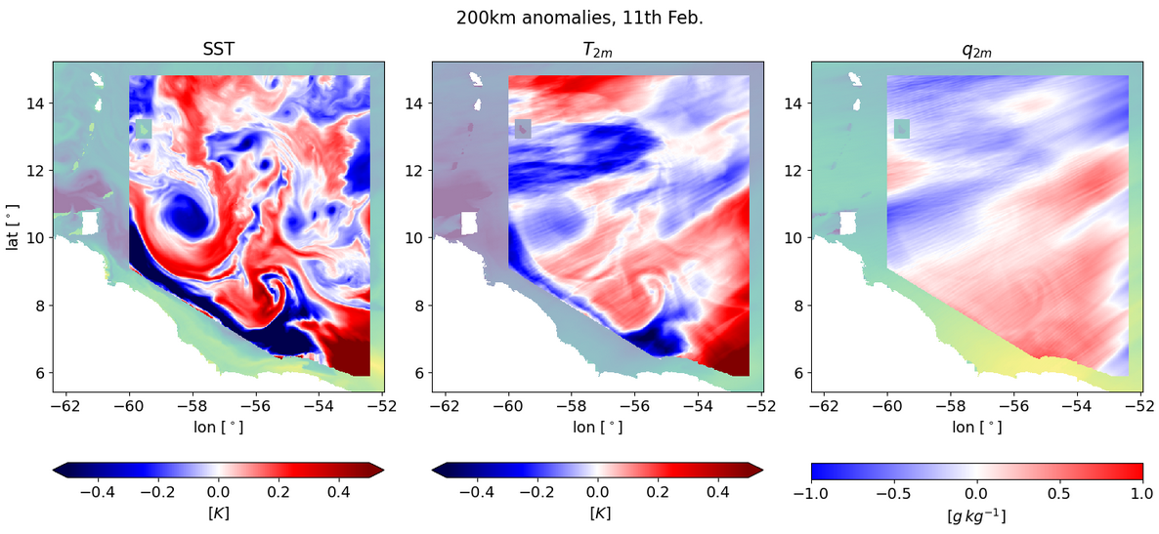
… to higher complexity – The coupled simulation
High-pass filtered fields (200 km) – 11th Feb. 2020

Slide 5

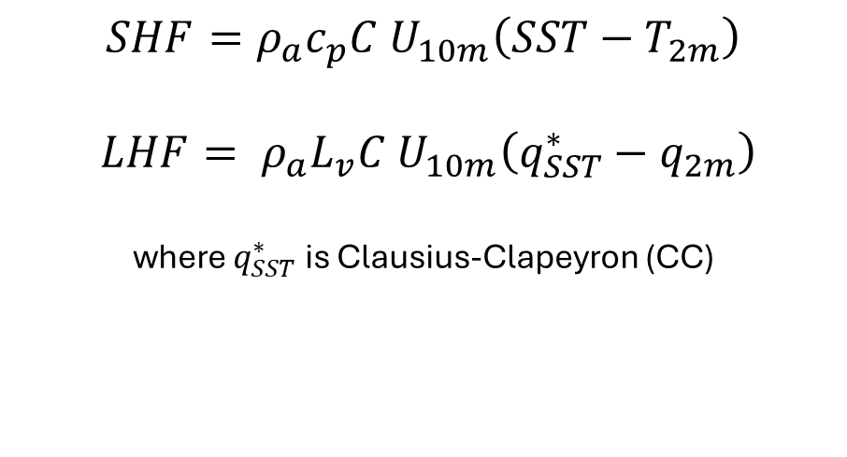
Sensitivity of surface fluxes to SST
MABL
$$SHF=ρ_{a}c_{p}C U_{10m}\left(SST−T_{2m}\right)$$
$$LHF= ρ_{a}L_{v}C U_{10m}\left(q_{SST}^{∗}−q_{2m}\right)$$
where $q_{SST}^{∗}$ is Clausius-Clapeyron (CC)
SHF’ ?
LHF’ ?
SHF’ ?
LHF’ ?
$$sensitivities == \frac{∂HF′}{∂SST′}$$
SST’ < 0
SST’ > 0
Notes:
Check how WRF is computing surface fluxes in the coupled simulation

Slide 6
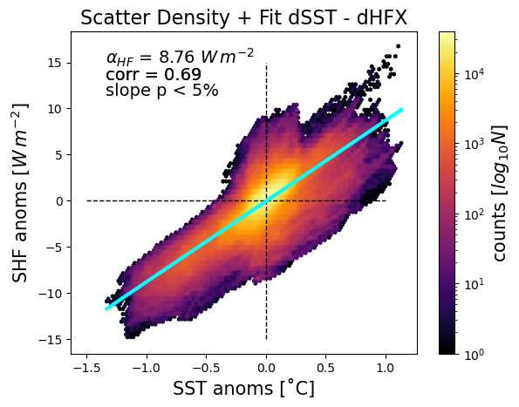
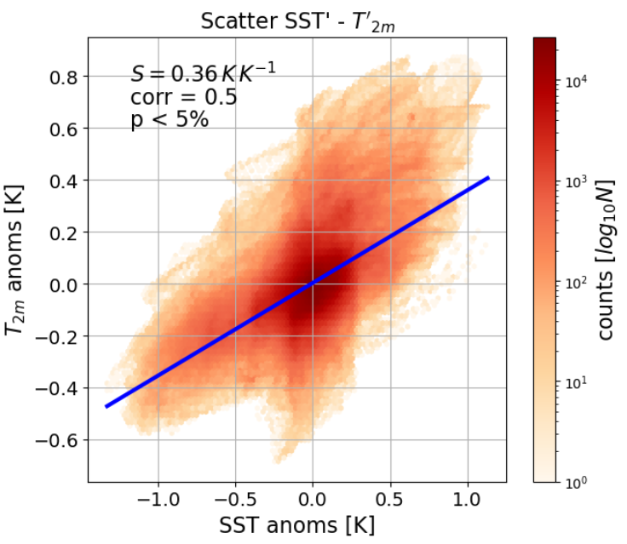

SENSIBLE HEAT FLUX
SHF anomalies
$T_{2m}$ anomalies

Slide 7
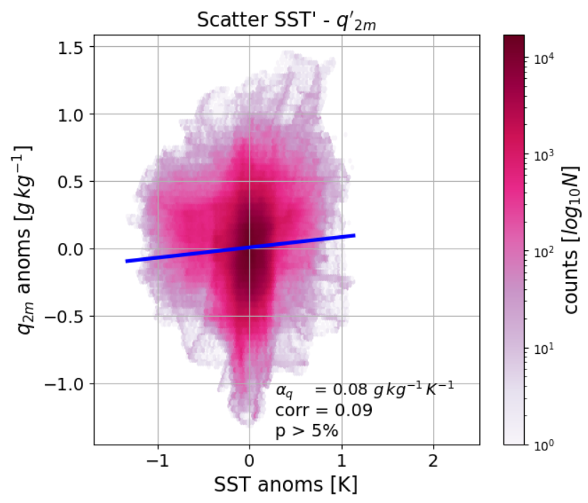
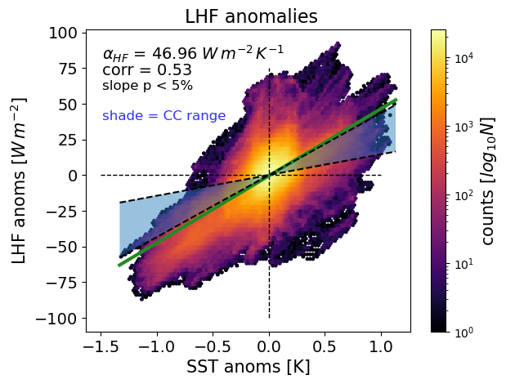
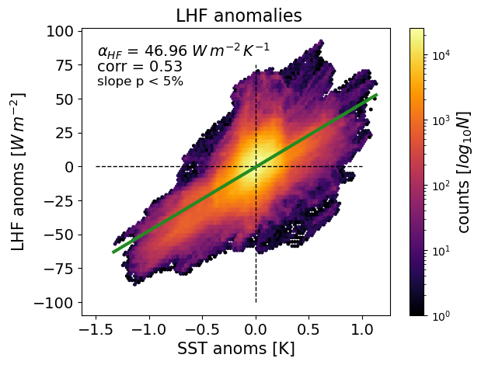
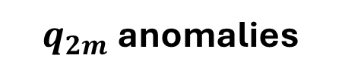
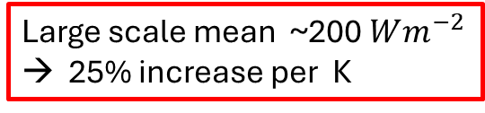
LATENT HEAT FLUX
LHF anomalies
$q_{2m}$anomalies
Large scale mean ~$\text{200} Wm^{−2}$
→ 25% increase per K

Slide 8
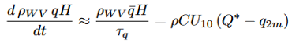
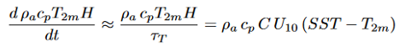
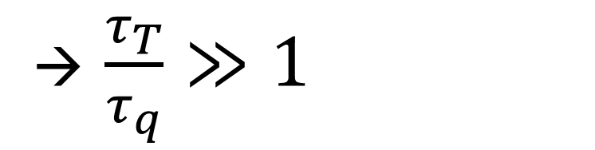
How to explain the different responses?
?
Different adjustment rates to surface fluxes?
→ $\frac{τ_{T}}{τ_{q}}≫1$
MABL’
SST’ < 0
SST’ > 0
Notes:
$q_{2m}$ IS SET BY BALANCE BETWEEN ENTRAINMENT AND SURFACE FLUXES

Slide 9
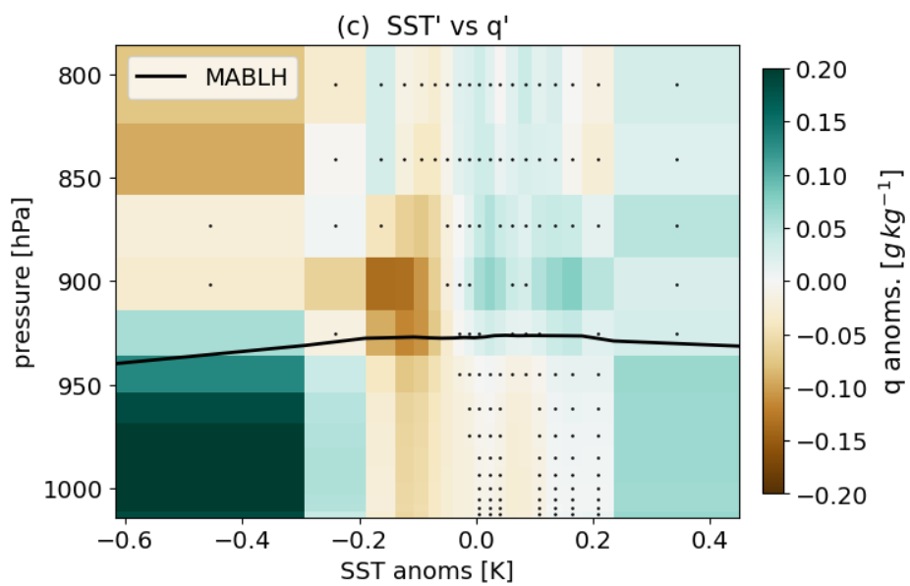
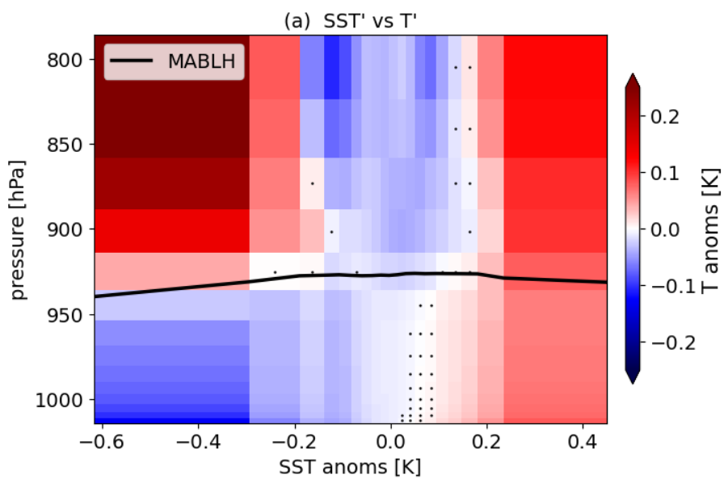
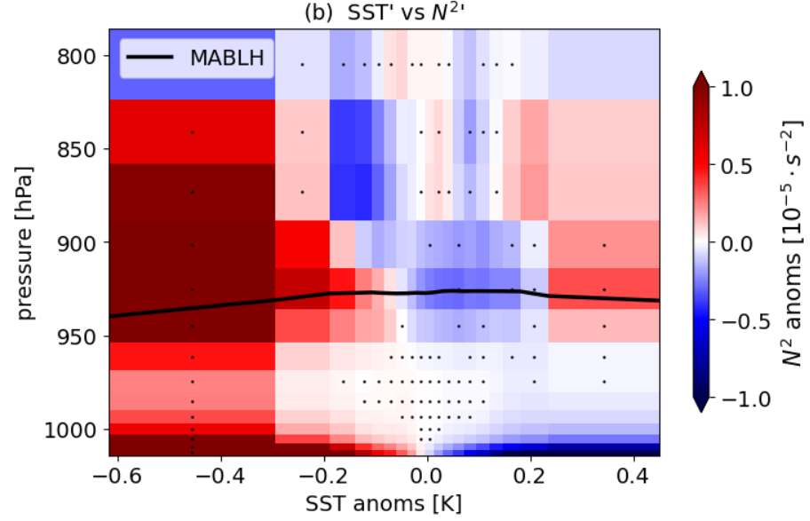
Response of the air column
Specific humidity anomalies
Temperature anomalies
Stability anomalies
Compare with
Borgnino et al. 2025

Slide 10
Conclusions
MABL’
Moisture set by
SURFACE FLUXES
ENTRAINED DOWNWELLING
Feedback enhancing
surface flux exchange
SST’ < 0
SST’ > 0

Slide 11
References
Acquistapace, C., Meroni, A. N., Labbri, G., Lange, D., Späth, F., Abbas, S., and Bellenger, H. (2022): Fast atmospheric response to a cold oceanic mesoscale patch in the north-western tropical Atlantic, Journal of Geophysical Research: Atmospheres, 127, e2022JD036 799, https://doi.org/10.1029/2022JD036799
Bony, S. and Dufresne, J.-L. (2005): Marine boundary layer clouds at the heart of tropical cloud feedback uncertainties in climate models, Geophysical Research Letters, 32, https://doi.org/10.1029/2005GL023851
Borgnino, M., Desbiolles, F, Meroni, A., and Pasquero, C. (2025) : Lower Tropospheric Response to Local Sea Surface Temperature Anomalies: A Numerical Study in the EUREC4A Region, Geophysical Research Letters, 52, e2024GL112 294 https://doi.org/10.1029/2024GL112294
Conejero, C., Renault, L., Desbiolles, F., McWilliams, J. C., and Giordani, H. (2024): Near-Surface Atmospheric Response to Meso- and Sub-mesoscale Current and Thermal Feedbacks, Journal of Physical Oceanography, 54, 823–848, https://doi.org/10.1175/2024.
Gentemann, C. L., Clayson, C. A., Brown, S., Lee, T., Parfitt, R., Farrar, J. T., Bourassa, M., Minnett, P. J., Seo, H., Gille, S. T. et al. (2020), Fluxsat: measuring the ocean–atmosphere turbulent exchange of heat and moisture from space, Remote Sensing 12(11), 1796, https://doi.org/10.3390/rs12111796
Naumann, A. K., Stevens, B. and Hohenegger, C. (2019), A moist conceptual model for the boundary layer structure
and radiatively driven shallow circulations in the trades , Journal of the Atmospheric Sciences 76(5), 1289–1306,
Seo, H., O’Neill, L. W., Bourassa, M. A., Czaja, A., Drushka, K., Edson, J. B., Fox-Kemper, B., Frenger, I., Gille, S. T., Kirtman, B. P.,
Minobe, S., Pendergrass, A. G., Renault, L., Roberts, M. J., Schneider, N., Small, R. J., Stoffelen, A., and Wang, Q. (2023): Ocean Mesoscale and Frontal-Scale Ocean-Atmosphere Interactions and Influence on Large-Scale Climate: A Review, Journal of Climate, 36, 1981–2013, https://doi.org/10.1175/JCLI-D-21-0982.1,

Slide 12
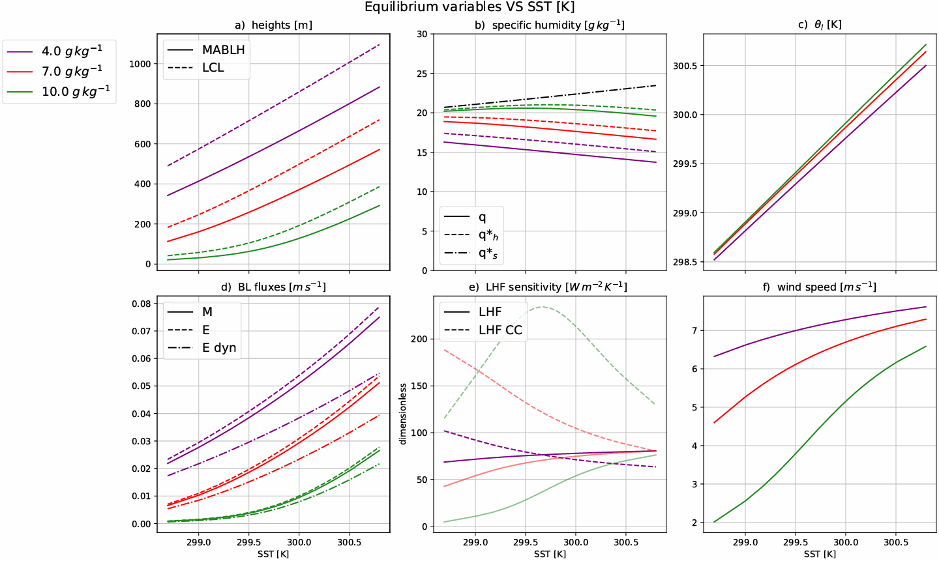
Full Bulk model analysis

Slide 13
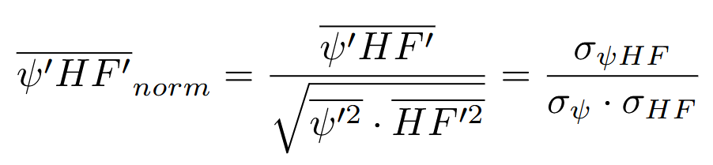
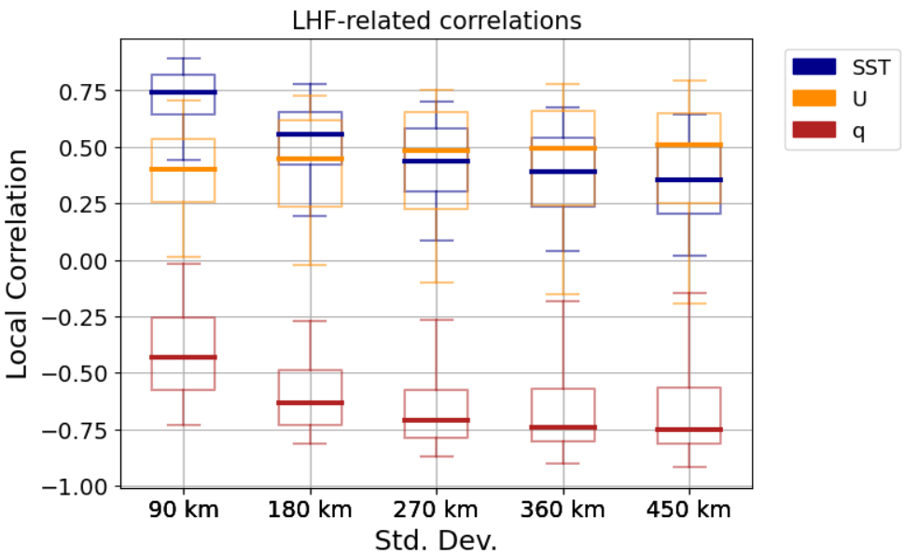
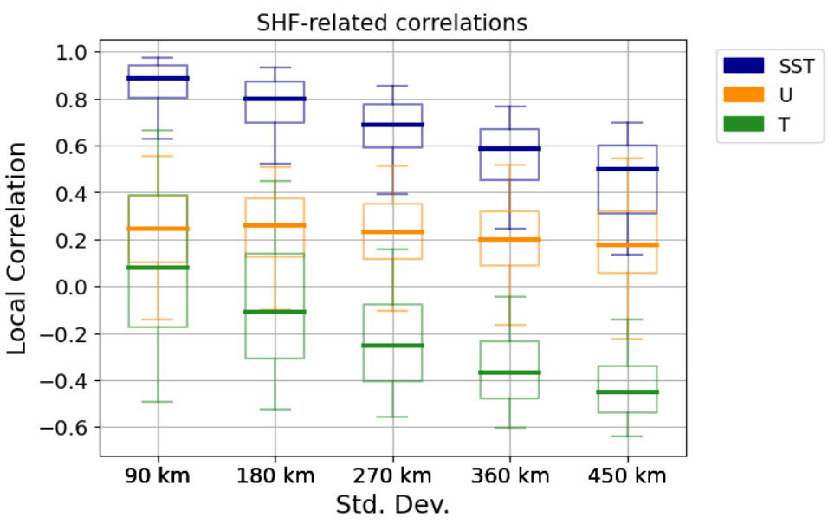
What’s driving heat fluxes?

Slide 14
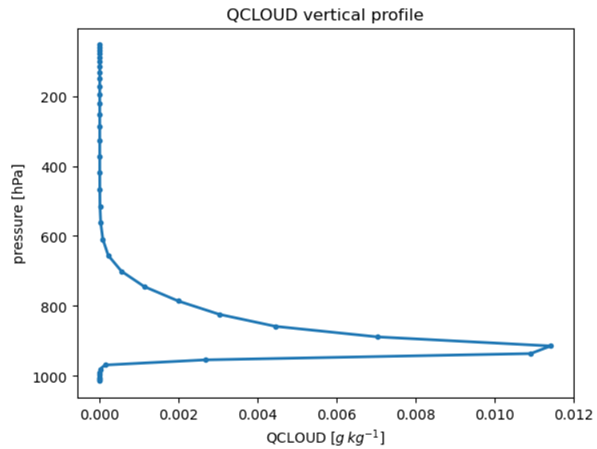
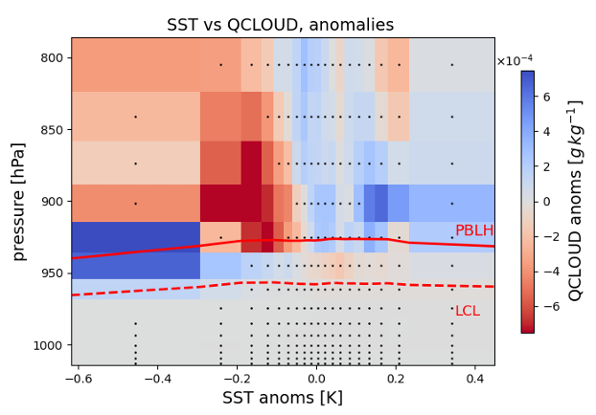
Liquid cloud water content mixing ratio (QCLOUD)
QCLOUD anomalies
COLD anomalies: lower cloud base, closer to LCL
WARM anomalies: higher cloud base, more mixing between LCL and MABL top

Slide 15
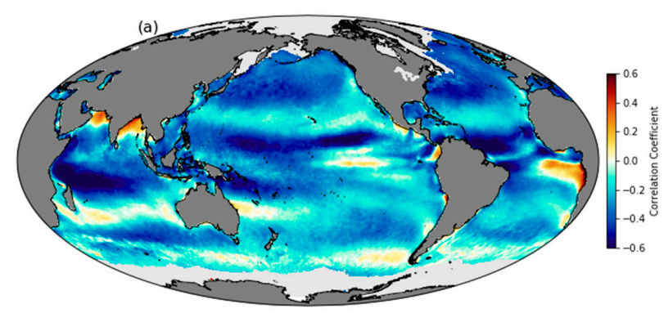
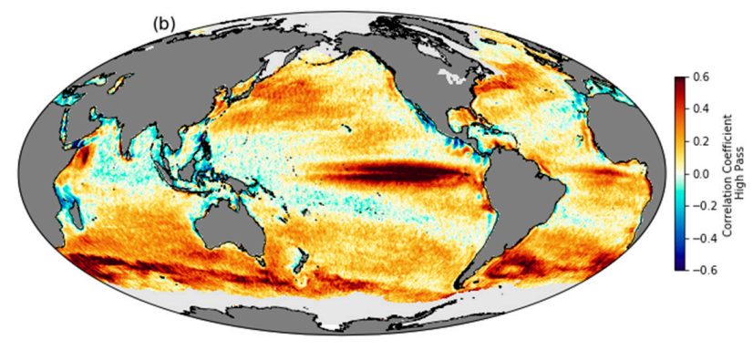
Introducing the local scale effects
Correlation between QuikScat wind speed and NOAA Optimum Interpolated SST using daily, 25-km-gridded data from 2000–2009.
Same, but for 1000km high-pass filtered data: notice the thorough change of correlation signs.
Gentemann et al. 2020

Slide 17
Radiative budget
T , q air
wind
SST, q source
Turbulent fluxes
LHF, SHF
currents
Notes:
the coupling between marine shallow
trade-wind clouds and circulation is known to play a cen-
tral role in the uncertainty of the tropical cloud feedback and climate sensitivity estimated by models

Slide 18
INTRODUCING THE LOCAL SCALE
Correlation between QuikScat wind speed and NOAA Optimum Interpolated SST using daily, 25-km-gridded data from 2000–2009.
Same, but for 1000km high-pass filtered data: notice the thorough change of correlation signs.
Gentemann et al. 2020

Slide 19
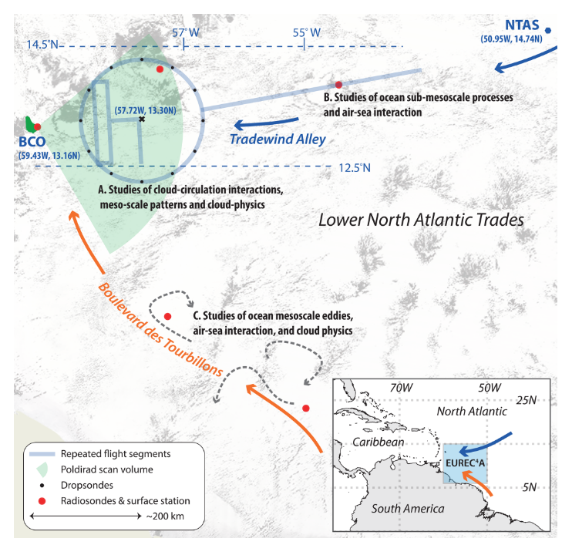
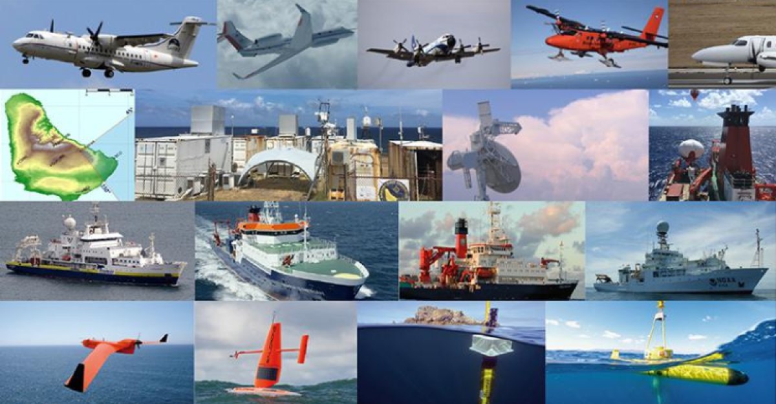
The EUREC4A - ATOMIC campaign Stevens et al 2021
Investigate small scale air-sea coupling and cloud-convection feedbacks
Notes:
ElUcidating the RolE of Cloud–Circulation Coupling in ClimAte - Atlantic Tradewind Ocean–Atmosphere Mesoscale Interaction

Slide 20
CORE QUESTION
what is the impact of mesoscale SST variability
on the atmospheric fields and surface fluxes?
HOW?
STATISTICAL ANALYSES ON DAILY AVERAGES
Response of air column
Sensitivity of HFs to SST
Analysis of LHF spatial variance
Simulation characteristics:
Ocean: CROCO, 1km, 4yr spin-up
Atmosphere: WRF v4.2 , 2km, 1-month spin up:
Nested into a larger domain, forced with hourly ERA5 outputs, downscaled onto a 6km intermediate buffer grid
COUPLING:
OASIS3-MCT coupler
WRF → CROCO: hourly means of momentum and heat fluxes
CROCO → WRF: SST-related heat fluxes and stress modifications by surface currents
Details in Conejero et al. 2024

Slide 21
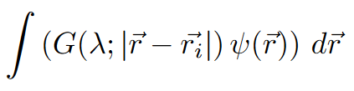
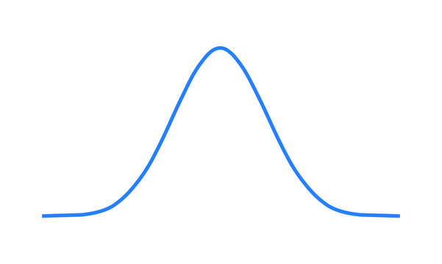
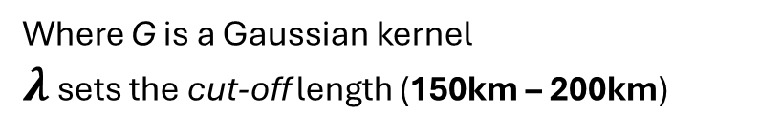
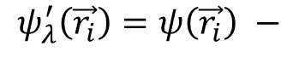
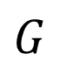
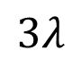
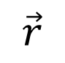
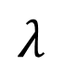
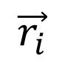
METHODS - a first glimpse
Anomalies == high-pass filtered data
$$ψ_{λ}^{′}\left(\vec{r_{i}}\right)=ψ\left(\vec{r_{i}}\right) −$$
Where G is a Gaussian kernel
$λ$ sets the cut-off length (150km – 200km)
$$G$$
$$λ$$
STATISTICAL SIGNIFICANCE: subsampling according to autorrelation lengthscales
$$\vec{r_{i}}$$
$$\vec{r}$$
$$3λ$$

Slide 22
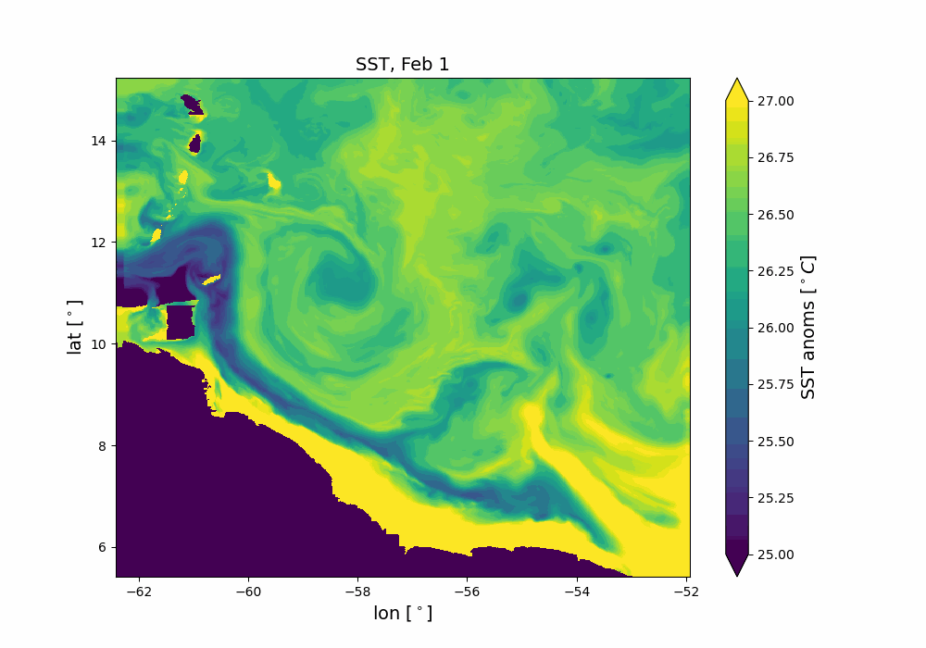
METHODS - a first glimpse
Anomalies == high-pass filtered data
$$ψ_{λ}^{′}\left(\vec{r_{i}}\right)=ψ\left(\vec{r_{i}}\right) −$$
Where G is a Gaussian kernel
$λ$ sets the cut-off length (150km – 200km)
$$G$$
$$λ$$
STATISTICAL SIGNIFICANCE: subsampling according to autorrelation lengthscales
$$\vec{r_{i}}$$
$$\vec{r}$$
$$3λ$$

Slide 23

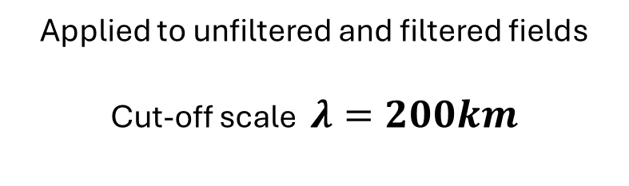
Sensitivity of surface thermodynamic fluxes to SST
HOW?
Linear regressions against SST
SST’ > 0
SST’ < 0
$Δ$SST → $Δ$HFs ?
Applied to unfiltered and filtered fields
Cut-off scale $λ=200km$

Slide 24
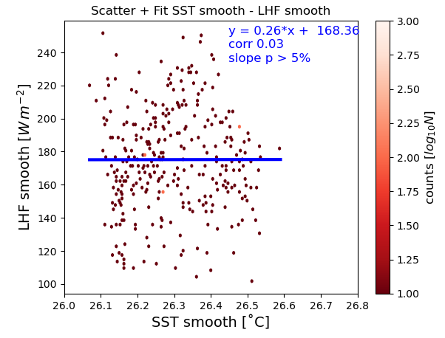
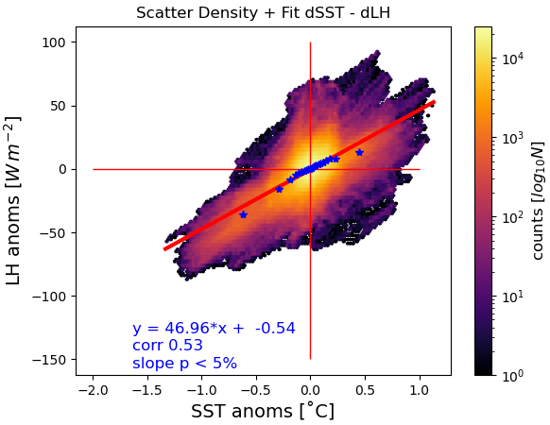

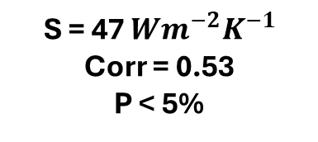
$$\frac{∂LHF}{∂SST}=\frac{∂ ρ_{a}C U_{10m}(q_{SST}^{∗}−q_{2m})}{∂SST}$$
Low – pass
High – pass
Corr = 0.03
P > 5%
S = 47 $Wm^{−2}K^{−1}$
Corr = 0.53
P < 5%
LHF ANOMALIES STRONGLY DEPEND ON SMALL SCALE SST PATTERNS!

Slide 25
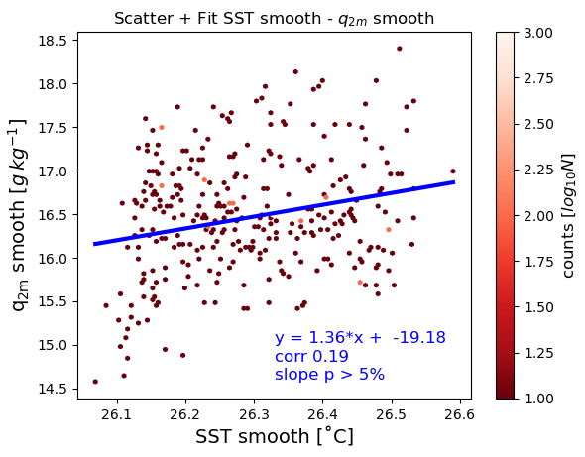
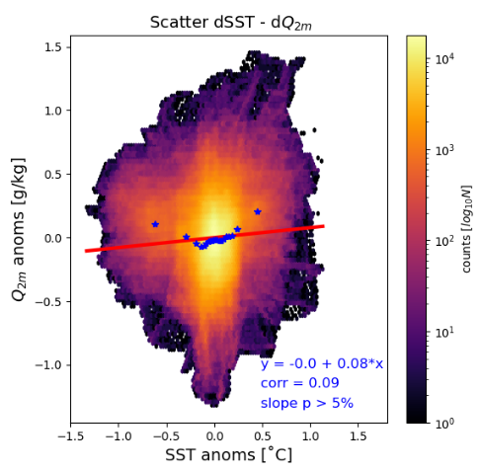
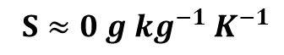
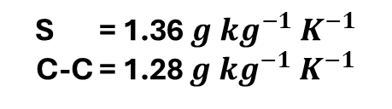
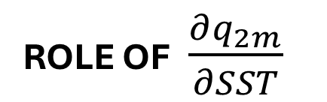
ROLE OF $\frac{∂q_{2m}}{∂SST}$
Low – pass
High – pass
$S≈0 {g kg^{−1} K}^{−1}$
S = 1.36 ${g kg^{−1} K}^{−1}$
C-C = 1.28 ${g kg^{−1} K}^{−1}$
MAIN CONCLUSION: $q_{2m}$IS INDEPENDENT OF SST ANOMALIES!
Notes:
The large scale – only sensitivity of 2m moisture instead follows CC

Slide 26
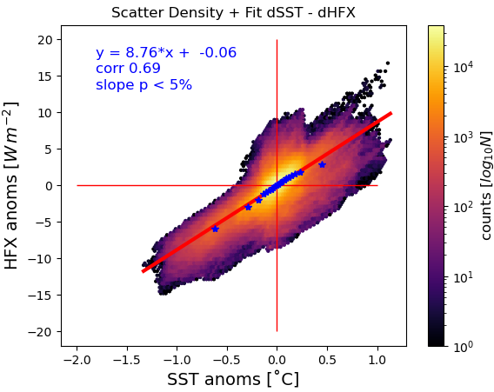
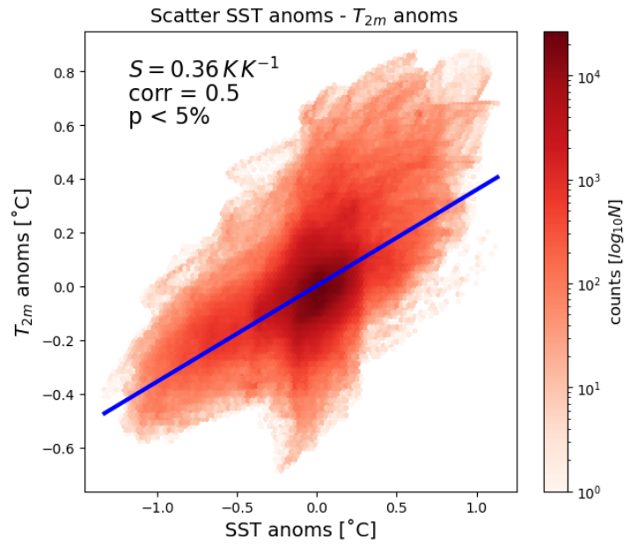


SENSIBLE HEAT FLUX
$\frac{∂HFX′}{∂SST′}$ $\frac{∂T_{2m}′}{∂SST′}$
dSHF
S = 8.76 $Wm^{−2}K^{−1}$
Corr = 0.69
P < 5%
SHF
MESOSCALE $T_{2M}$ DOES NOT ADJUST TO SST !

Slide 27






HOW DO THERMODYNAMIC SENSITIVITIES
CONTRIBUTE TO HFs TOTAL COUPLING?
$$ρ_{a}C U_{10m}\frac{ ∂(q_{SST}^{∗}−q_{2m})}{∂SST}$$
$$ρ_{a}C U_{10m}\frac{∂\left(SST −T_{2m}\right)}{∂SST}$$
$$\frac{∂LHF′}{∂SST′}=47 Wm^{−2}K^{−1}$$
$$\frac{∂SHF′}{∂SST′}=8.7 Wm^{−2}K^{−1}$$
Recall …

Slide 28


Ideal MABL:
Vertically homogeneous
NO horizontal advection
ONLY surface fluxes
Newtonian relaxation
MABL
LHF, SHF
→ $\frac{τ_{T}}{τ_{q}}≫1$
MABL would saturate faster than it would heat up
$q_{2m}$ IS SET BY BALANCE BETWEEN ENTRAINMENT AND SURFACE FLUXES

Slide 29
Response of the air column following SST anomalies
HOW?
Percentile bins
MABL
Split data into 5% or 2% bins for every vertical level and take mean of every bin
Pressure – SST cross sections
SST’ > 0
SST’ < 0
Borgnino et al. 2024 , under revision

Slide 30


Moisture budget and relative humidity
Water vapour anomalies
Temperature anomalies
WVMR’
SST anomalies constrain only SATURATION, not WVMR

Slide 31
Liquid cloud water content mixing ratio
COLD anomalies: lower cloud base, closer to LCL
WARM anomalies: higher cloud base, more mixing between LCL and MABL top
NET EXPORT OF MOISTURE AND CLOUD WATER FROM PBL

Slide 32

Enhanced entrainment WARMS and DRIES the MABL
Entrainment feedbacks
On surface fluxes
SST modifies fluxes
Borgnino et al. 2024

Slide 33

Is SST actually the dominant factor driving LHF?
HOW?
Local covariances
with Gaussian kernel

Slide 34




Decompose LHF in a large and a small-scale component
OVERBAR = low-pass filter, $λ=150km$
From here, define the local correlation metric

Slide 35





NORMALIZED COVARIANCES («LOCAL CORRELATIONS»)
scales $<150 km$
$$60km<scales <150km$$
$$ψ_{i}=\left(SST, U, q\right)$$
SST variability dominates at small scales
U leads variability at larger scales
q is important in inhibiting LHF release

Slide 36

In the end …
We studied the influence of mesoscale SST patterns on atmospheric variables
SST anomalies DO modify surface fluxes
SST anomalies DO impact static stability and thus MABL turbulence
SST anomalies DO NOT constrain MABL moisture, but T and clouds
SSTs dominate the spatial variability of LHF
FUTURE RESEARCH
- How can we quantify entrainment?
How do coupling feedbacks actually shape SST?
SMOCs ?

Slide 37
Supplementary Material
LOCAL VARIANCES
LOCAL COVARIANCES

Slide 38

The Gulf Stream case
OPERATIONAL DEFINITION OF OCEANIC MESOSCALE
Notes:
The literature on GS is immense, I really cannot dedicate much time on it: just know that it is so energetic

Slide 39

Credits: Allison Wing

Slide 40


TWO MAIN MABL RESPONSE MECHANISMS
Pressure Adjustment (PA)
Downward Momentum mixing (DMM)
$∇⋅\vec{u}=α_{PA}∇^{2}SST$
$∂_{r}u_{r}=α_{DM} ∂_{r}SST$
weak wind, neutral column
strong wind, unstable air
Secondary circulation
THERMODYNAMIC FEEDBACKS
strong wind and
neutral stability conditions
Altitude
Mean profile
Wind speed
Pasquero et al. 2021, Desbiolles et al. 2023
Notes:
conditions relative to SST structure scale

Slide 41

Getting to know the simulation …
Observations from R/V MS Merian in Boulevard des Tourbillons

Slide 42


No wind variability in lower troposphere
Rare deep convection and limited rain
Notes:
Std pressure: 3h
Frequency of cloud liquid water over 600hPa is less than 5% over the whole month

Slide 43
Supplementary material: Air column response

Slide 44


Mean vertical profiles

Slide 45




Brunt – Vaisala frequency (BV - $N^{2}$)
Notes:
Scale is common
subsiding air in the trade winds regio

Slide 46

Figure 8 from Acquistapace et al., 2022: Height-sea surface temperature (SST) section of the rain-free
diurnal anomalies of [...] (b) latent heat flux (LHF) estimated from Atmospheric Raman Temperature and Humidity. Sounder and Doppler lidars observations.
The measured MABL height settled at around 500m over colder SSTs and 750m over warmer ones

Slide 47


Wind speed and horizontal convergence

Slide 48


Variability of vertical wind speed

Slide 49


Boundary layer height (PBLH)

Slide 50


Lifting Condensation Level (LCL)

Slide 51


Relating PBLH and LCL

Slide 52




HOW DO THERMODYNAMIC SENSITIVITIES
CONTRIBUTE TO HFs TOTAL COUPLING?
$$ρ_{a}C U_{10m}\frac{ ∂(q_{SST}^{∗}−q_{2m})}{∂SST}$$
$$ρ_{a}C U_{10m}\frac{∂\left(SST −T_{2m}\right)}{∂SST}$$

Slide 53
Supplementary material:
variance analysis

Slide 54

Visualizing the band-pass filter…

Slide 55

What is the role of coupling in shaping SST ?

Slide 56




SST-LHF local covariances

Slide 57




U-LHF local covariances

Slide 58




Q-LHF local covariances

Slide 59






Decompose LHF in a large and a small-scale component
SST TERMS
NON-SST TERMS

Slide 60


HOW IS THE TOTAL $\overline{LHF^{′2}}$ RECONSTRUCTED?
density pdf
SST-related explain much when small scales are included
NON-SST-related explain more when small scales are neglected
HP : high-pass
BP : band-pass
60km
150km

Slide 61


Slide 62
Humidity
Radiative balance
Convective
organization
wind
SST
Turbulent fluxes
LHF, HFX
currents
Notes:
the coupling between marine shallow
trade-wind clouds and circulation is known to play a cen-
tral role in the uncertainty of the tropical cloud feedback and climate sensitivity estimated by models

Slide 63

Be honest : How often do you think about oceans?

Slide 64


Not only MABL
GS is forcing the entire troposphere!
Minobe et al. 2010
Notes:
« to a surface convergence field, there corresponds a reaction by the whole troposphere

Slide 65

Reconstructed surface currents on 4th February 2020: peaks (yellow shadings) correspond to approx. 1m/s
Source: https://earth.nullschool.net/
Red box: the EUREC4A region
and computational domain

